Slide 1
Predictive Analysis Approach for Stroke Prediction using various Machine Learning Algorithm and Neural Networks
PROJECT PRESENTATION BY
A.Divya (EBEON0323785066)
August 24, 2023

Slide 2
DATA SCIENCE LIFECYCLE
01
Problem Statement
02
Data Mining
05
Feature Engineering
06
Predictive Modeling
03
Data Cleaning
04
Data Exploration

Slide 3
Problem Statement & Data mining
According to world health organization (who), stroke is known as the second leading cause of death globally, responsible for approximately 11% of total deaths.
This dataset was extracted freely from kaggle, a data science and machine learning community for research purposes. It provides relevant information about patients such as gender, age, various diseases, and smoking status. each row in the data provides relevant information about the patient.
In this project, we attempt to bridge the gap by providing a systematic analysis of the various customer records for the purpose of stroke prediction.
Problem SOLUTION

Slide 4
Attributes
Id: A unique identifier
gender: “Male”, “Female” or “Other”
age: age of the patient
hypertension: 0 if the patient doesn’t have hypertension, 1 if the patient has hypertension
heart_disease: 0 if the patient doesn’t have any heart diseases, 1 if the patient has a heart disease
ever_married: “No” or “Yes”
work_type: “children”, “Govt_job”, “Never_worked”, “Private” or “Self-employed”
Residence_type: “Rural” or “Urban”
avg_glucose_level:average glucose level in blood
bmi: body mass index
smoking_status: “formerly smoked”, “never smoked”, “smokes” or “Unknown”
stroke: 1 if the patient had a stroke or 0 if not

Slide 5
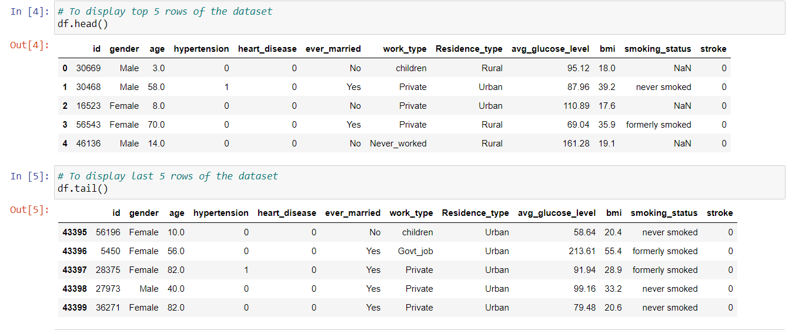
INSPECTING THE DATAFRAME
When you get a new DataFrame to work with, the first thing you need to do is explore it and see what it contains. There are several useful methods and attributes for this.

Slide 6
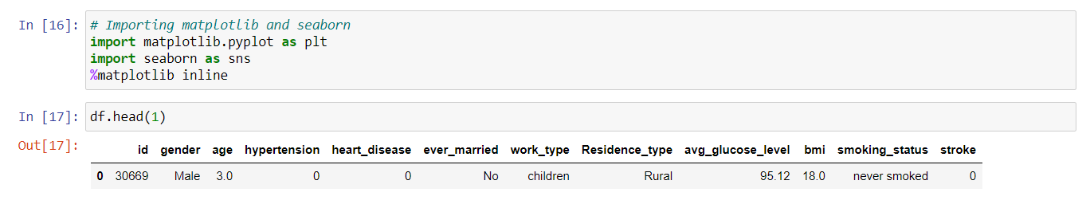
Data Visualization
Data visualization is a branch of data analysis that focuses on visualizing data. It plots data graphically and is a good way to communicate data inferences.
We used the below two libraries for data visualization
Matplotlib
Seaborn

Slide 7
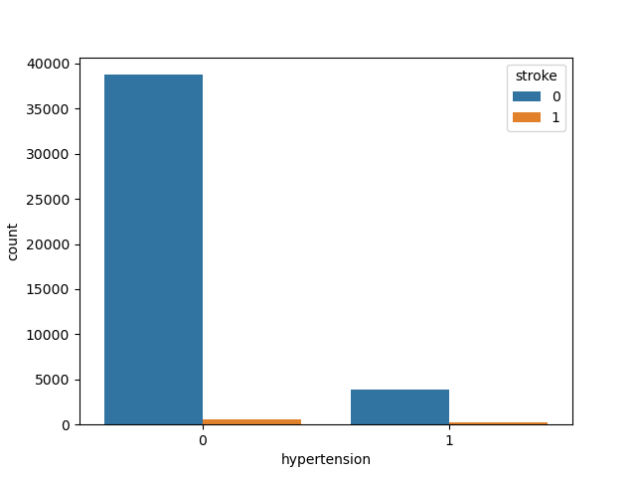
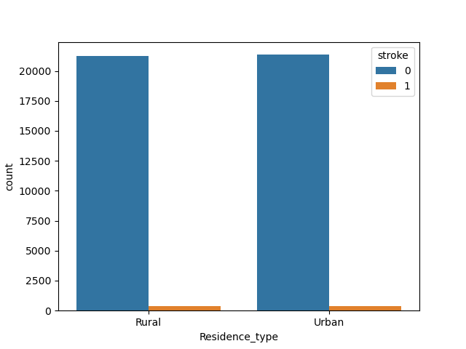
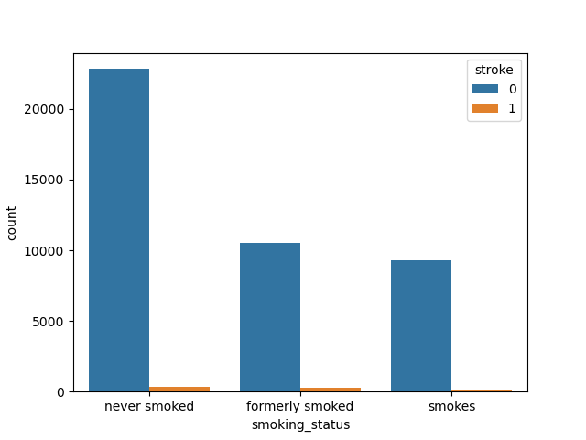
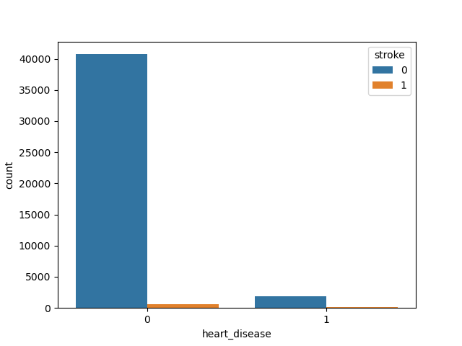
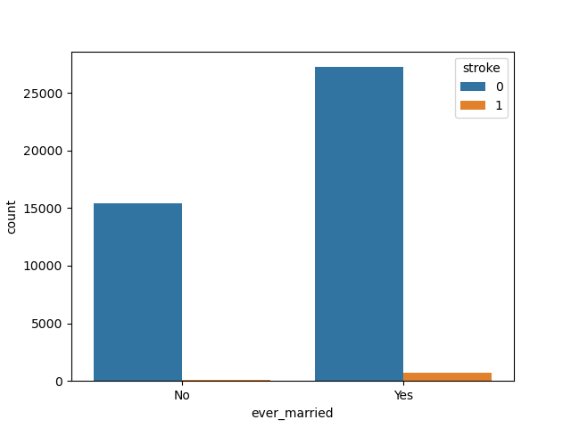
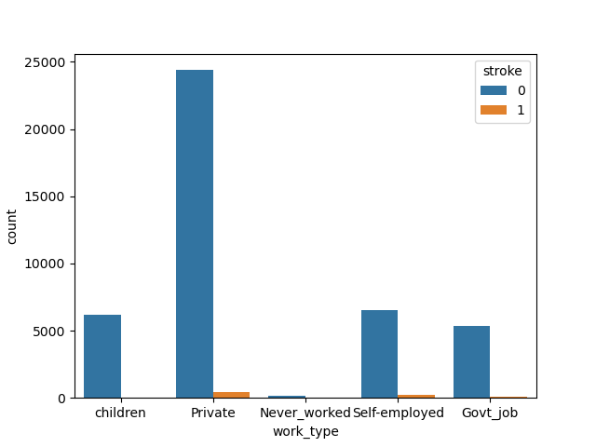
Categorical variable analysis = [hypertension, heart_disease, ever_married, work_type, Residence_type, smoking_status]

Slide 8
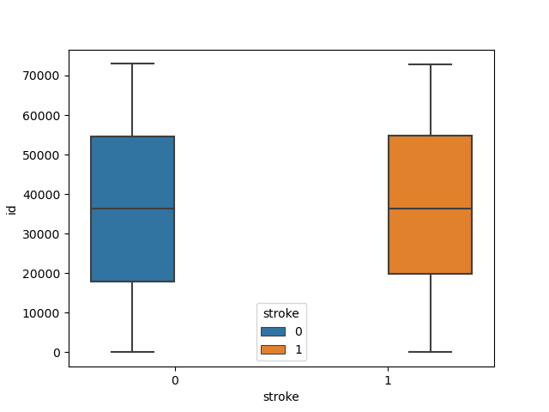
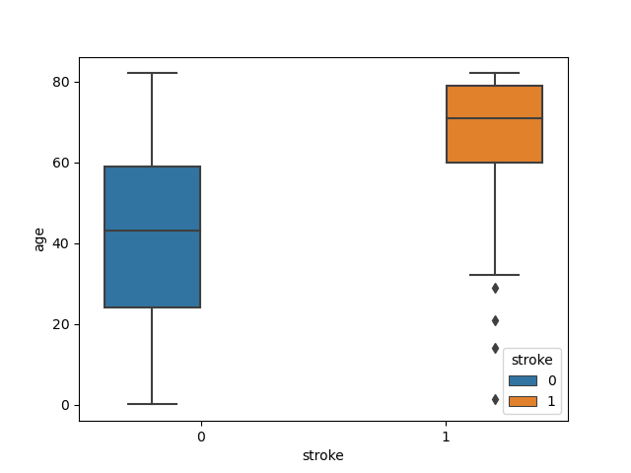
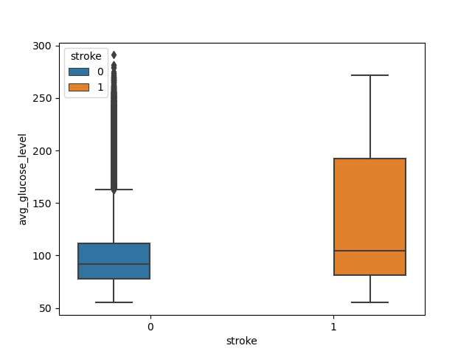
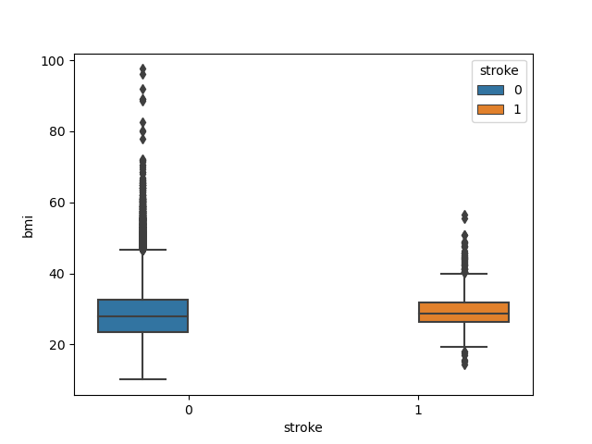
Continuous variable analysis = [id, age, avg_glucose_level, bmi]

Slide 9
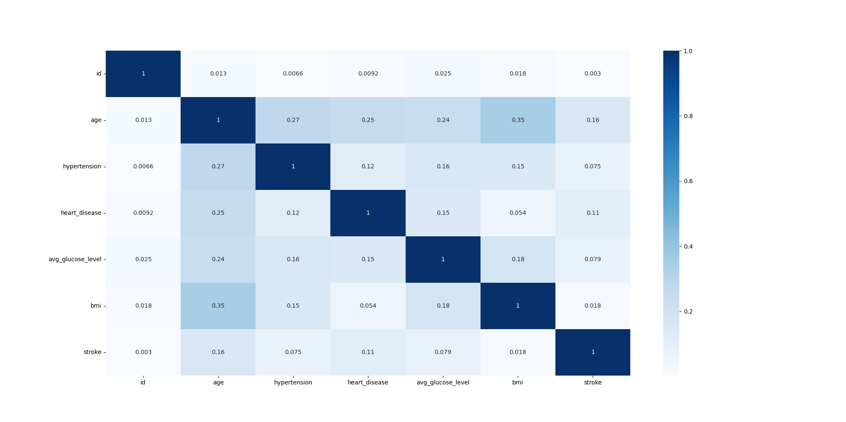
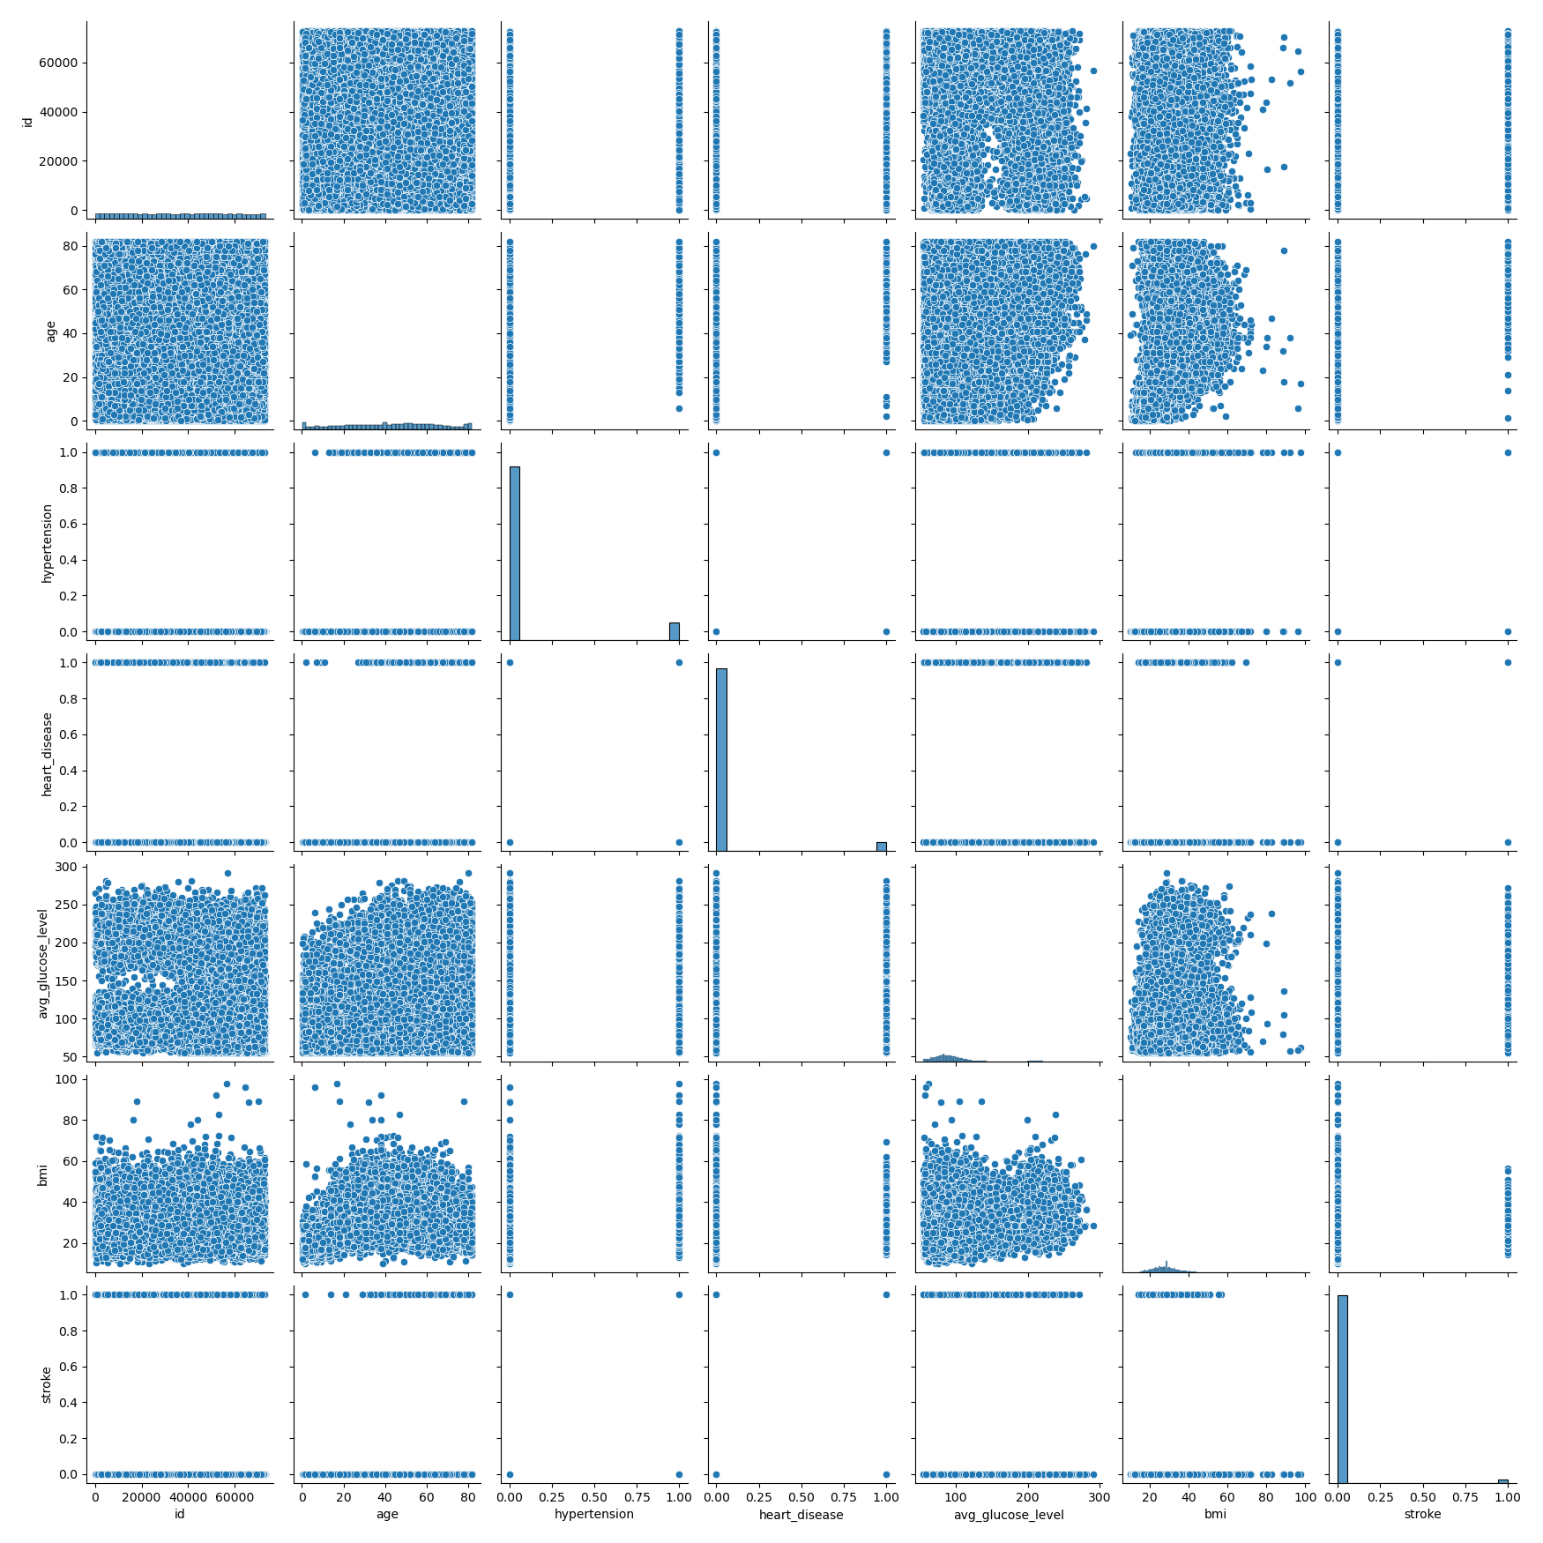
Correlation MATRIX
Pair Plot
The darker the color, highly corelated to stroke
The lighter the color, less corelated to stroke
The Hypertension, highly corelated to stroke
The ID, less corelated to stroke

Slide 10

Exploratory Data Analysis
EDA is applied to investigate the data and summarize the key insights.
It will give the basic understanding of the data, it’s distribution, null values and much more.
We can either explore data using graphs or through some python functions.

Slide 11
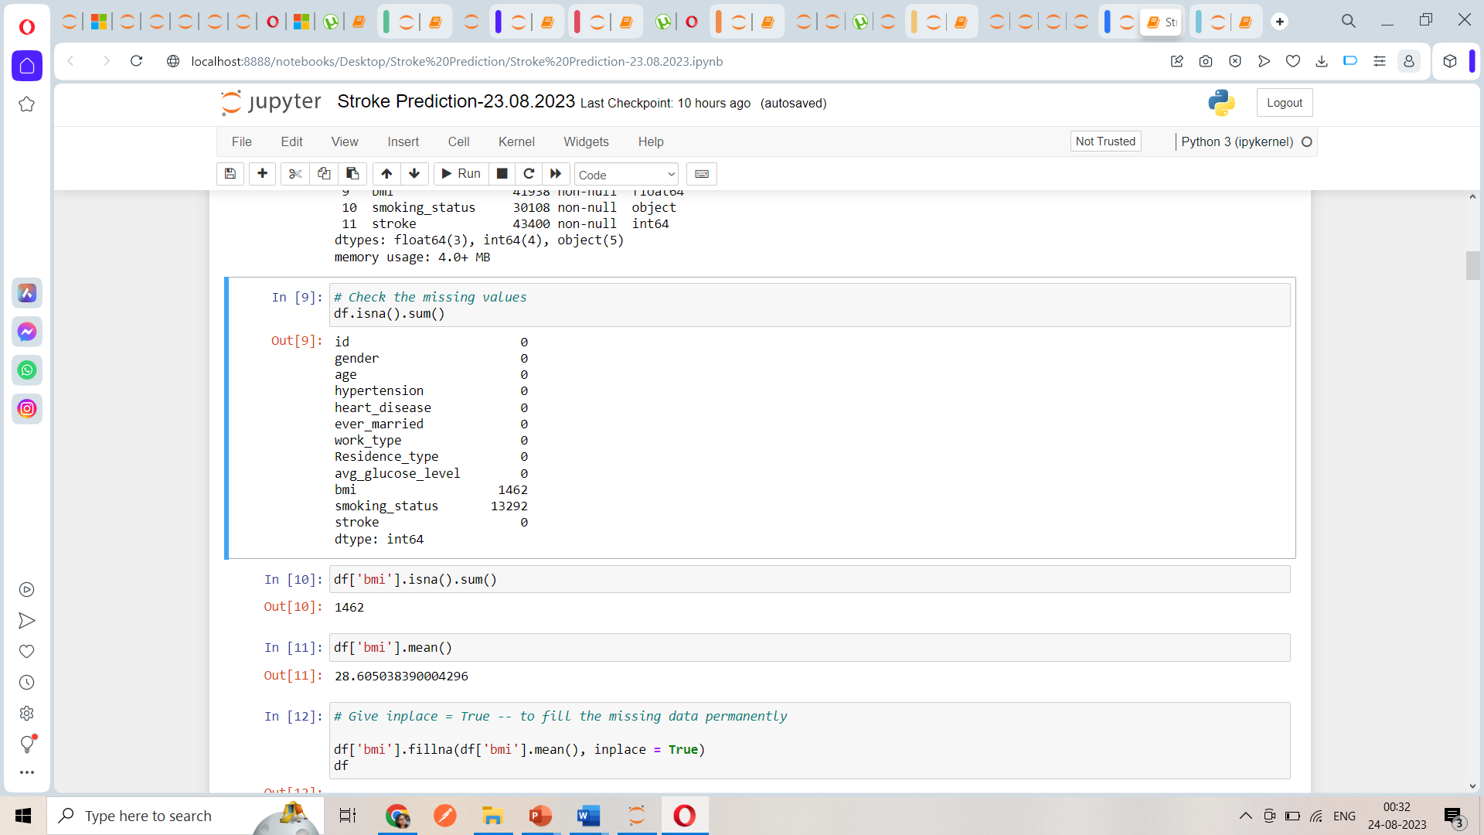
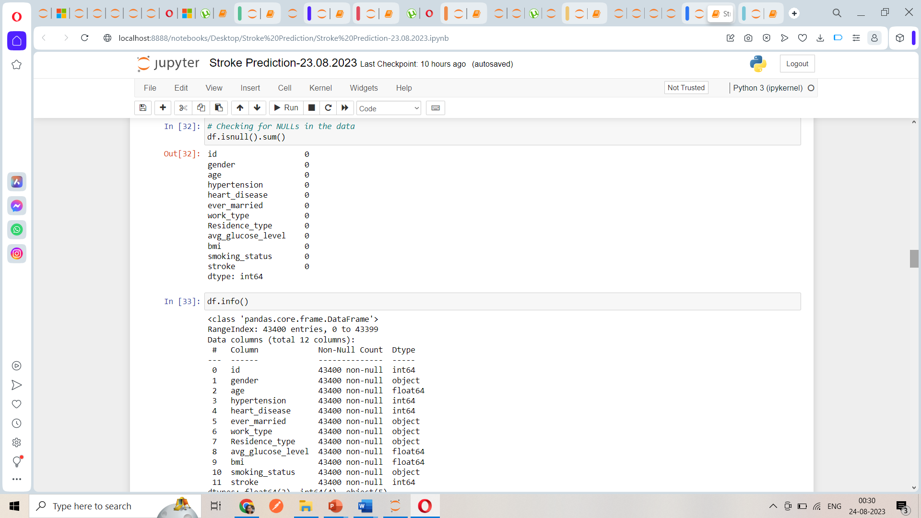
Data PRE-PROCESSING
In our data there are null values in BMI & Smoking_Status column
The null values are filled with mean and mode

Slide 12
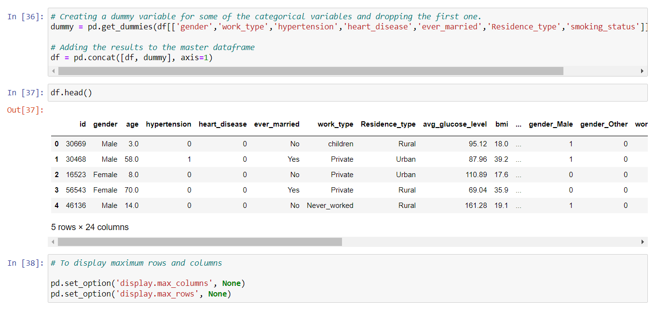
FEATURE ENGINEERING
dUMMY variables: useful because they allow us to include categorical variables in our analysis, which would otherwise be difficult to include due to their non-numeric nature.

Slide 13
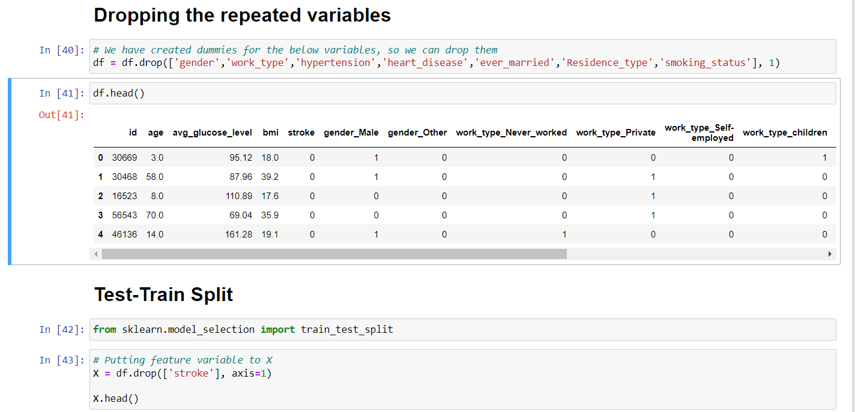
FEATURE ENGINEERING

Slide 14
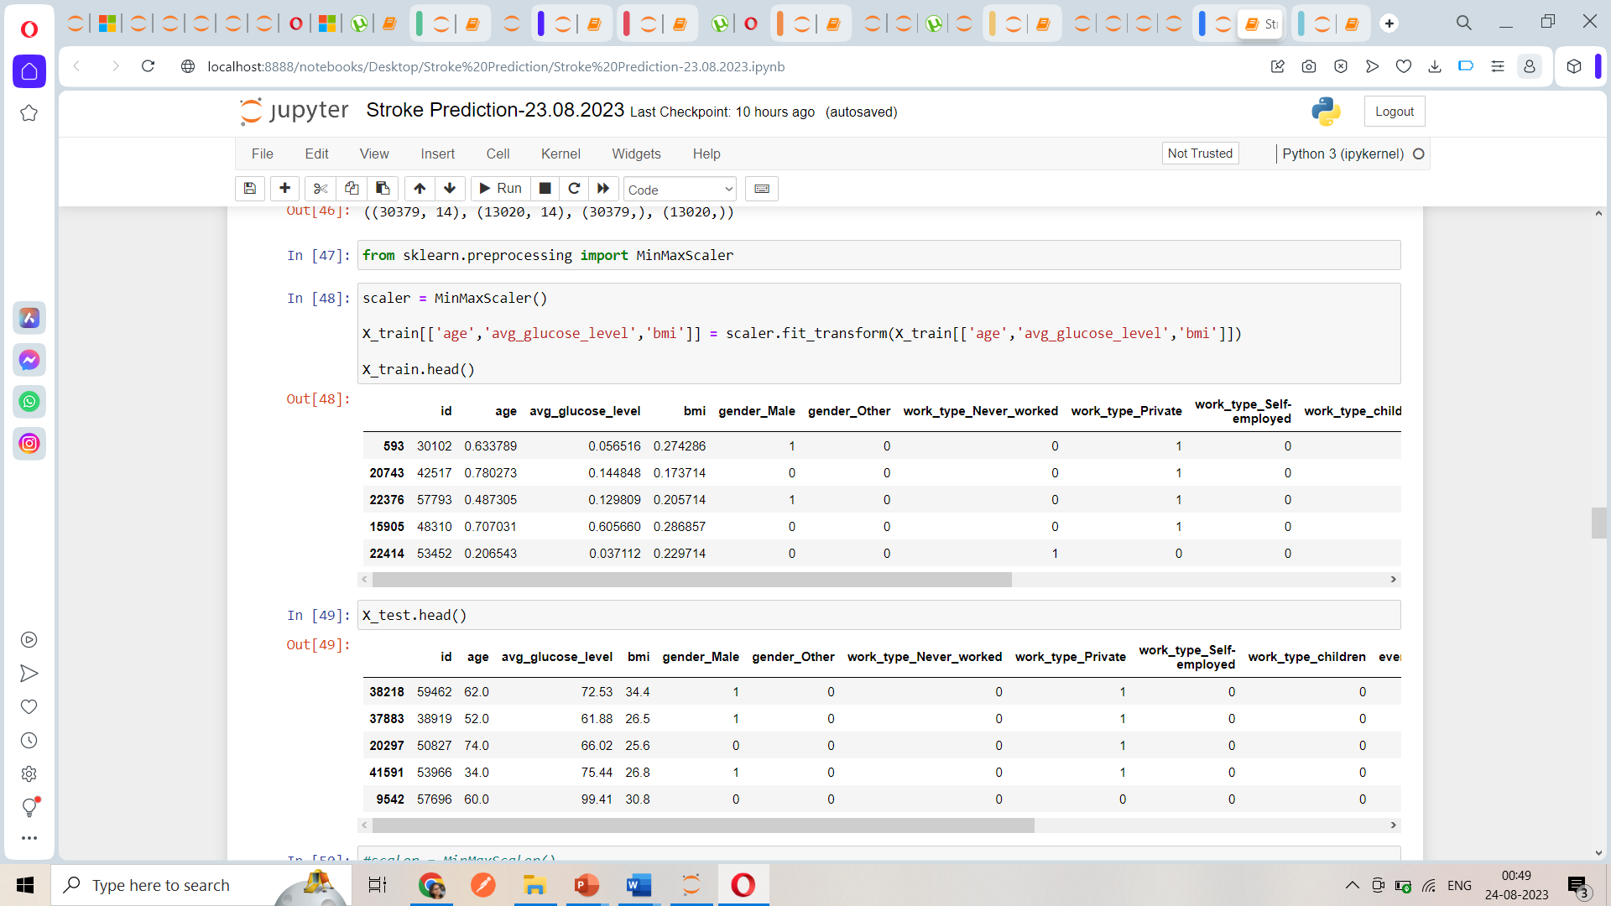
FEATURE ENGINEERING
Normalization technique is also referred to as scaling. The min-max scaling method helps the dataset to shift and rescale the values of their attributes, so they end up ranging between 0 and 1.

Slide 15
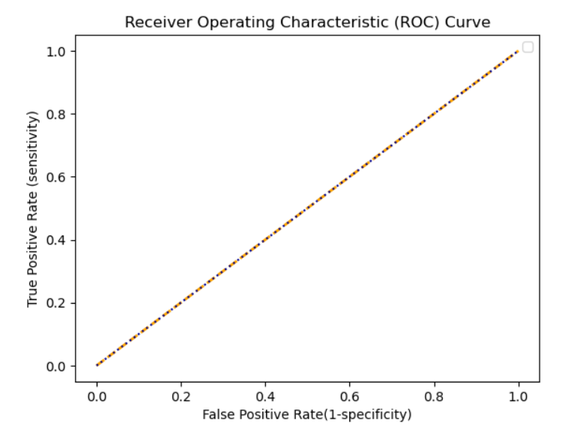
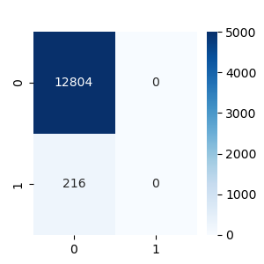
Model BUILDING
LOGISTIC REGRESSION
Library used : sklearn.linear_model (LogisticRegression)
Split used for training and testing the data : 70-30
Feature Scaling was performed after splitting the dataset to avoid information leakage on testing dataset by using Standardization method.
Accuracy : 98.3%
Recall :98%
Precision :100%

Slide 16
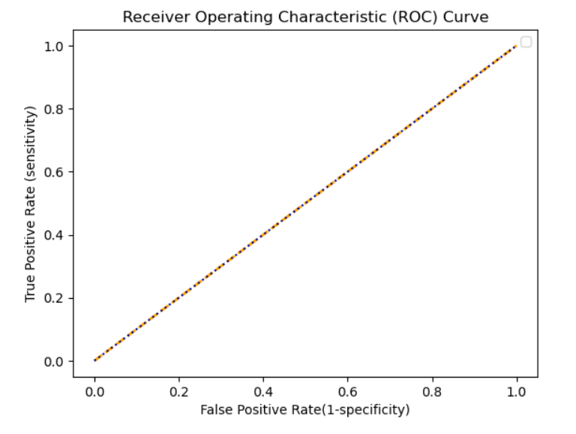
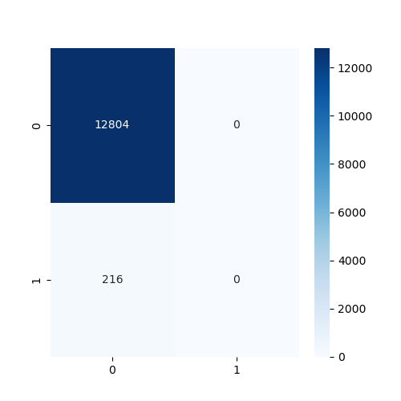
Model BUILDING
Support vector machine
Library used : sklearn.svm (SVC)
Split used for training and testing the data : 70-30
Feature Scaling was performed after splitting the dataset to avoid information leakage on testing dataset by using Standardization method.
Accuracy : 98.3%
Recall : 98%
Precision : 100%

Slide 17
Model BUILDING
DECISION TREE
Library used : sklearn.tree (DecisionTreeClassifier)
Split used for training and testing the data : 70-30
Feature Scaling was performed after splitting the dataset to avoid information leakage on testing dataset by using Standardization method.
Accuracy : 96.3%
Recall : 98%
Precision : 97%

Slide 18
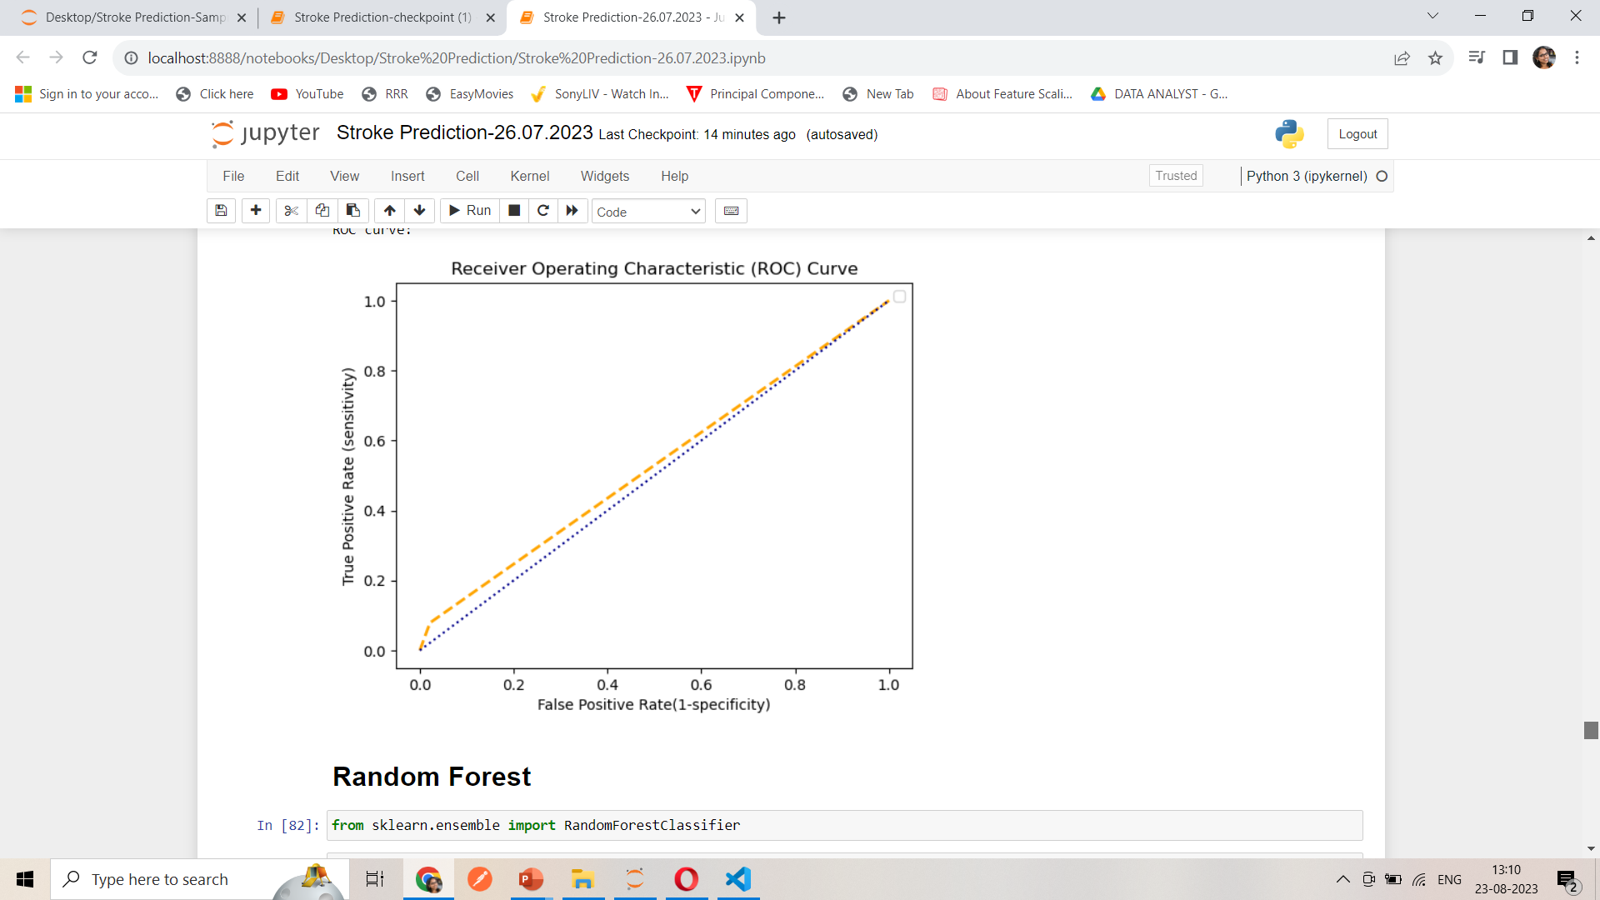
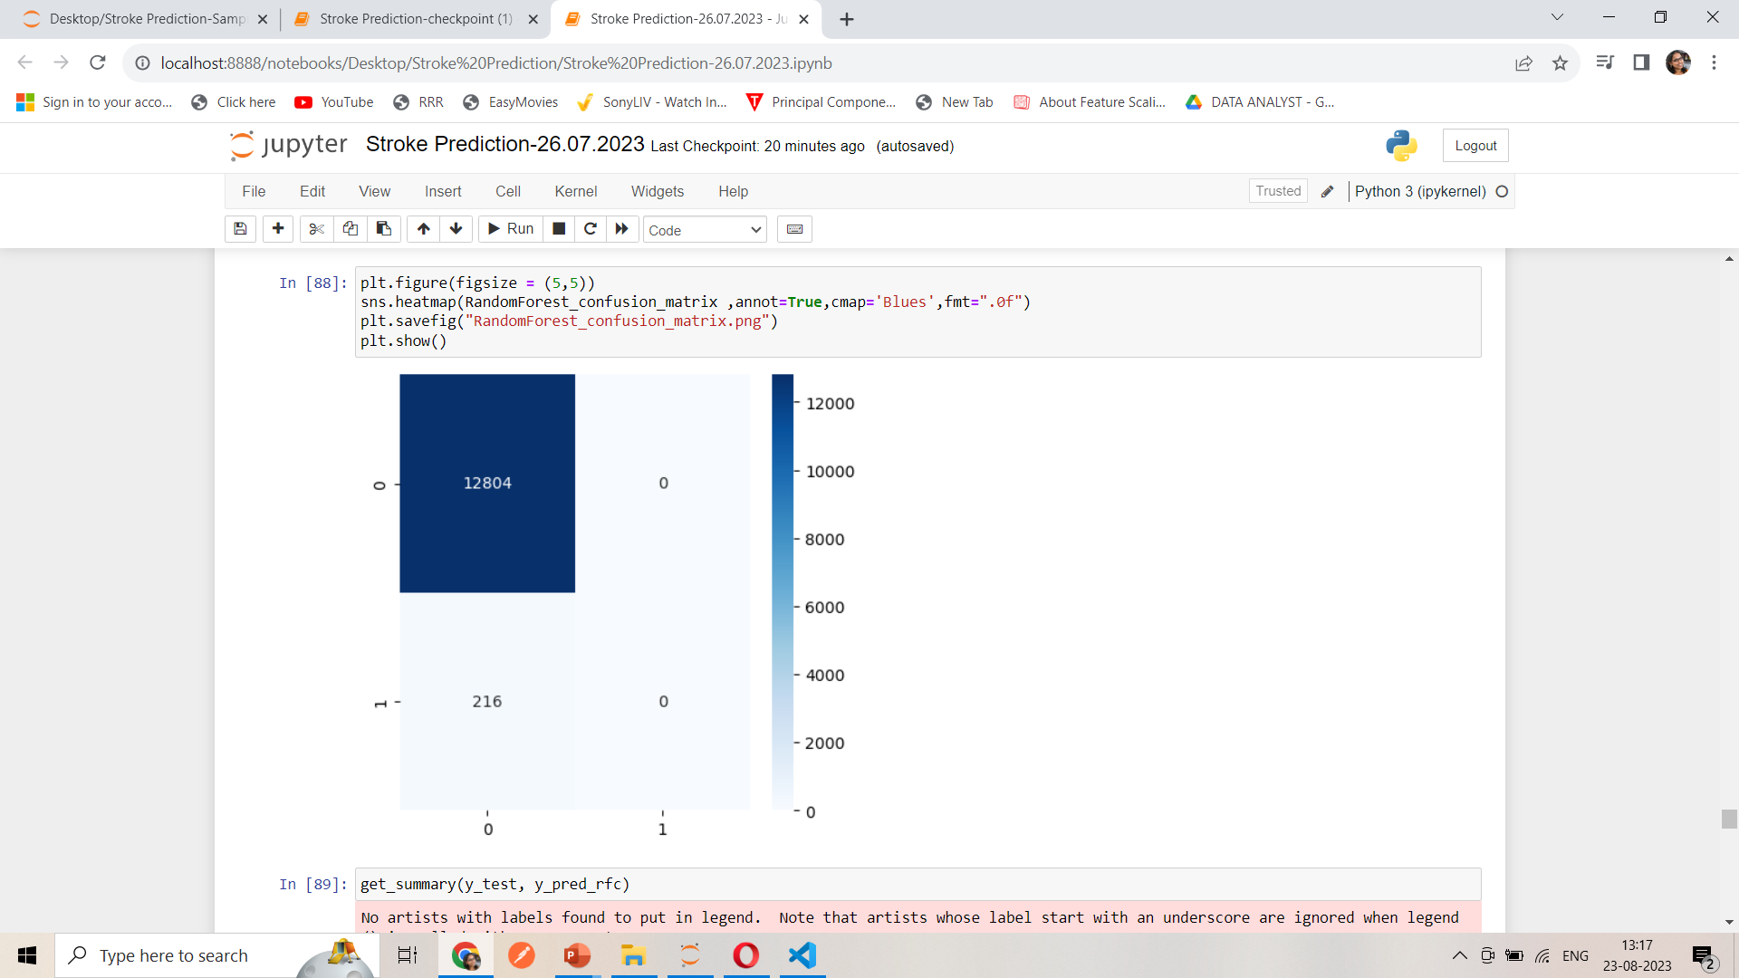
Model BUILDING
RANDOM FOREST
Library used : sklearn.ensemble (RandomForestClassifier)
Split used for training and testing the data : 70-30
Feature Scaling was performed after splitting the dataset to avoid information leakage on testing dataset by using Standardization method.
Accuracy : 98.3%
Recall : 98%
Precision : 100%

Slide 19
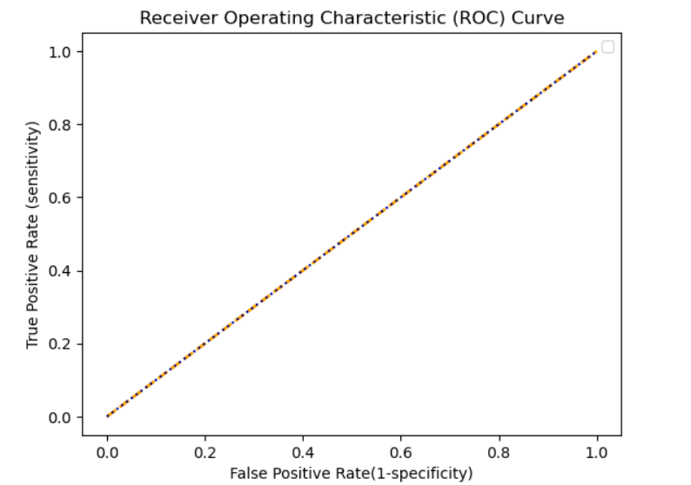

Model BUILDING
K-Nearest Neighbor
Library used : sklearn.neighbors (KNeighborsClassifier)
Split used for training and testing the data : 70-30
Feature Scaling was performed after splitting the dataset to avoid information leakage on testing dataset by using Standardization method.
Accuracy : 98.3%
Recall : 98%
Precision : 99%

Slide 20
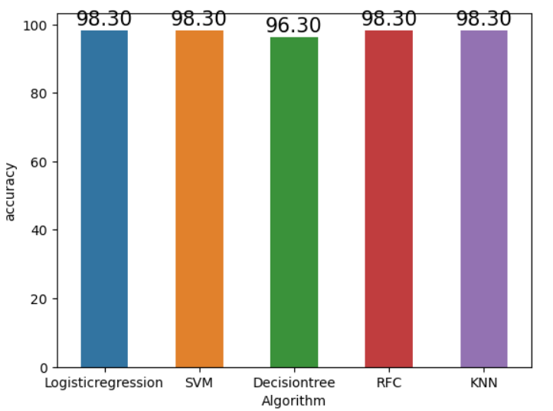
Accuracy comparison
We gathered the accuracy metrics of each model and made a comparison graph that shows the overall accuracies of each model.
Prediction models, Logistic Regression, Support Vector Machine, Decision Tree, Random Forest and K-Nearest Neighbor showed acceptable accuracy in identifying stroke-prone patients.
This project hence helps to predict the stroke risk using prediction model and provide personalized warning and the lifestyle correction message.
By doing so, it urges medical users to strengthen the motivation of health management and induce changes in their health behaviors.

Slide 21


Slide 22


